Slide 1
General Safety in Our Makerspace

Slide 2
Makerspaces can be dangerous
Treat the space with respect
Always follow safety guidelines

Slide 3
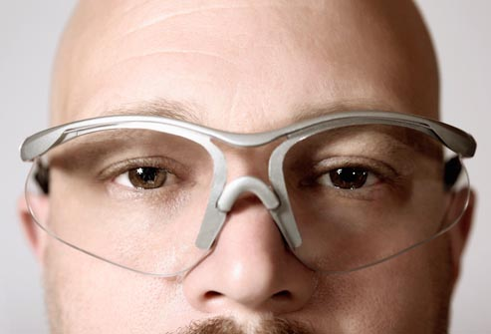
Use Protective Gear
Always wear safety glasses when you are in the shop area or using any tools.

Slide 4
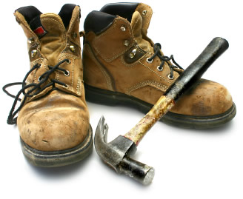
Wear Shoes That Cover Your Entire Foot
Any shoe that exposes your toes or heals can put you in danger of injury from:
Stuff falling on your feet
Chemicals spilling
Hot things burning your feet
Stubbing your toes on sharp objects

Slide 5
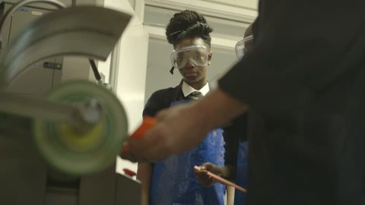
Tie Your Hair Back, Don’t Wear Anything That Can Get Tangled In Equipment
Loose clothing, dangling jewelry, and long hair can get tangled in equipment, even simple hand tools.

Slide 6
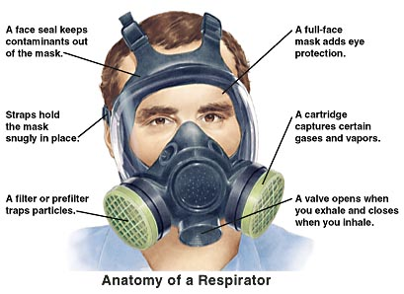
Wear a respirator when using spray paint or other aerosols, and a disposable mask when working with dust or biological organisms

Slide 7

Don’t Eat Or Drink In The Shop
Don’t bring any food or drink into the shop area.
Don’t eat or drink when you are operating machinery or using tools.

Slide 8
Always Make Sure You Are Familiar With The Equipment Before You Use It
Do not use any tool or piece of equipment unless you have been trained for it, and have passed the safety training for its use.
If you are unsure about the safe operation of any tool or equipment seek assistance before you touch it.
Some tools and machines require extra training beyond this safety training. Please look on the ‘subject experts’ white board to find trainers who can help you with equipment.

Slide 9
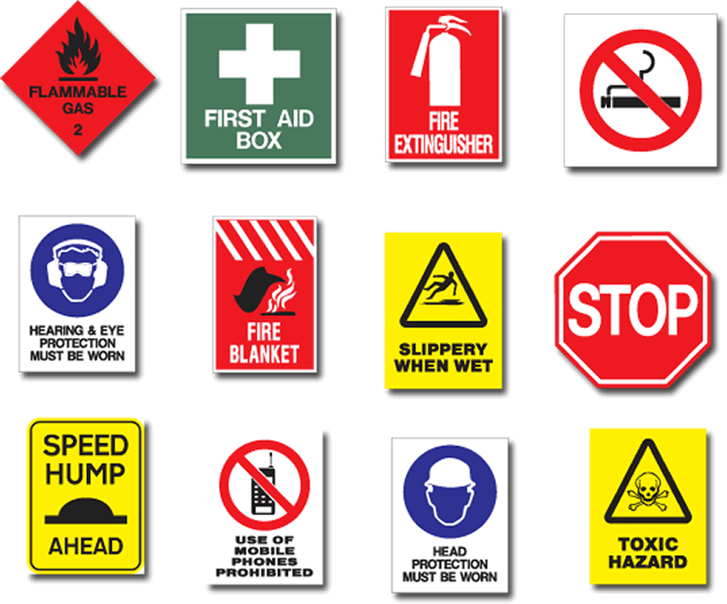
Observe All Signage
Become familiar with all caution and danger signs.
Be alert and pay attention to any alarms or verbal commands.
Follow the requirements on the MSDS (Material Safety Data Sheets).

Slide 10
Know where to find MSDS, kitty litter, safety glasses, and ear plugs
When entering the shop area, look to the right and you will find these items. Please become familiar with this area.
If you bring or store your own chemicals at Quelab, make sure it is labeled with the contents and owner of the chemical. We have a cd that provides MSDS for most of the chemicals we use, but please check and provide MSDS if it’s not on the database (check for cd in the MSDS binder).

Slide 11
Follow the two person rule when working with certain equipment. Equipment that requires someone else in the area while you are working includes the full size lathe and the milling machine. If you’re not sure about a piece of equipment, please ask the area officer.

Slide 12
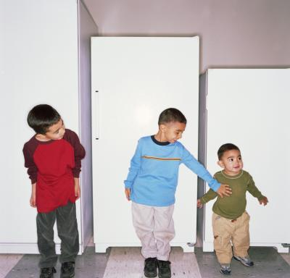
Respect The Shop Space – No Horseplay

Slide 13
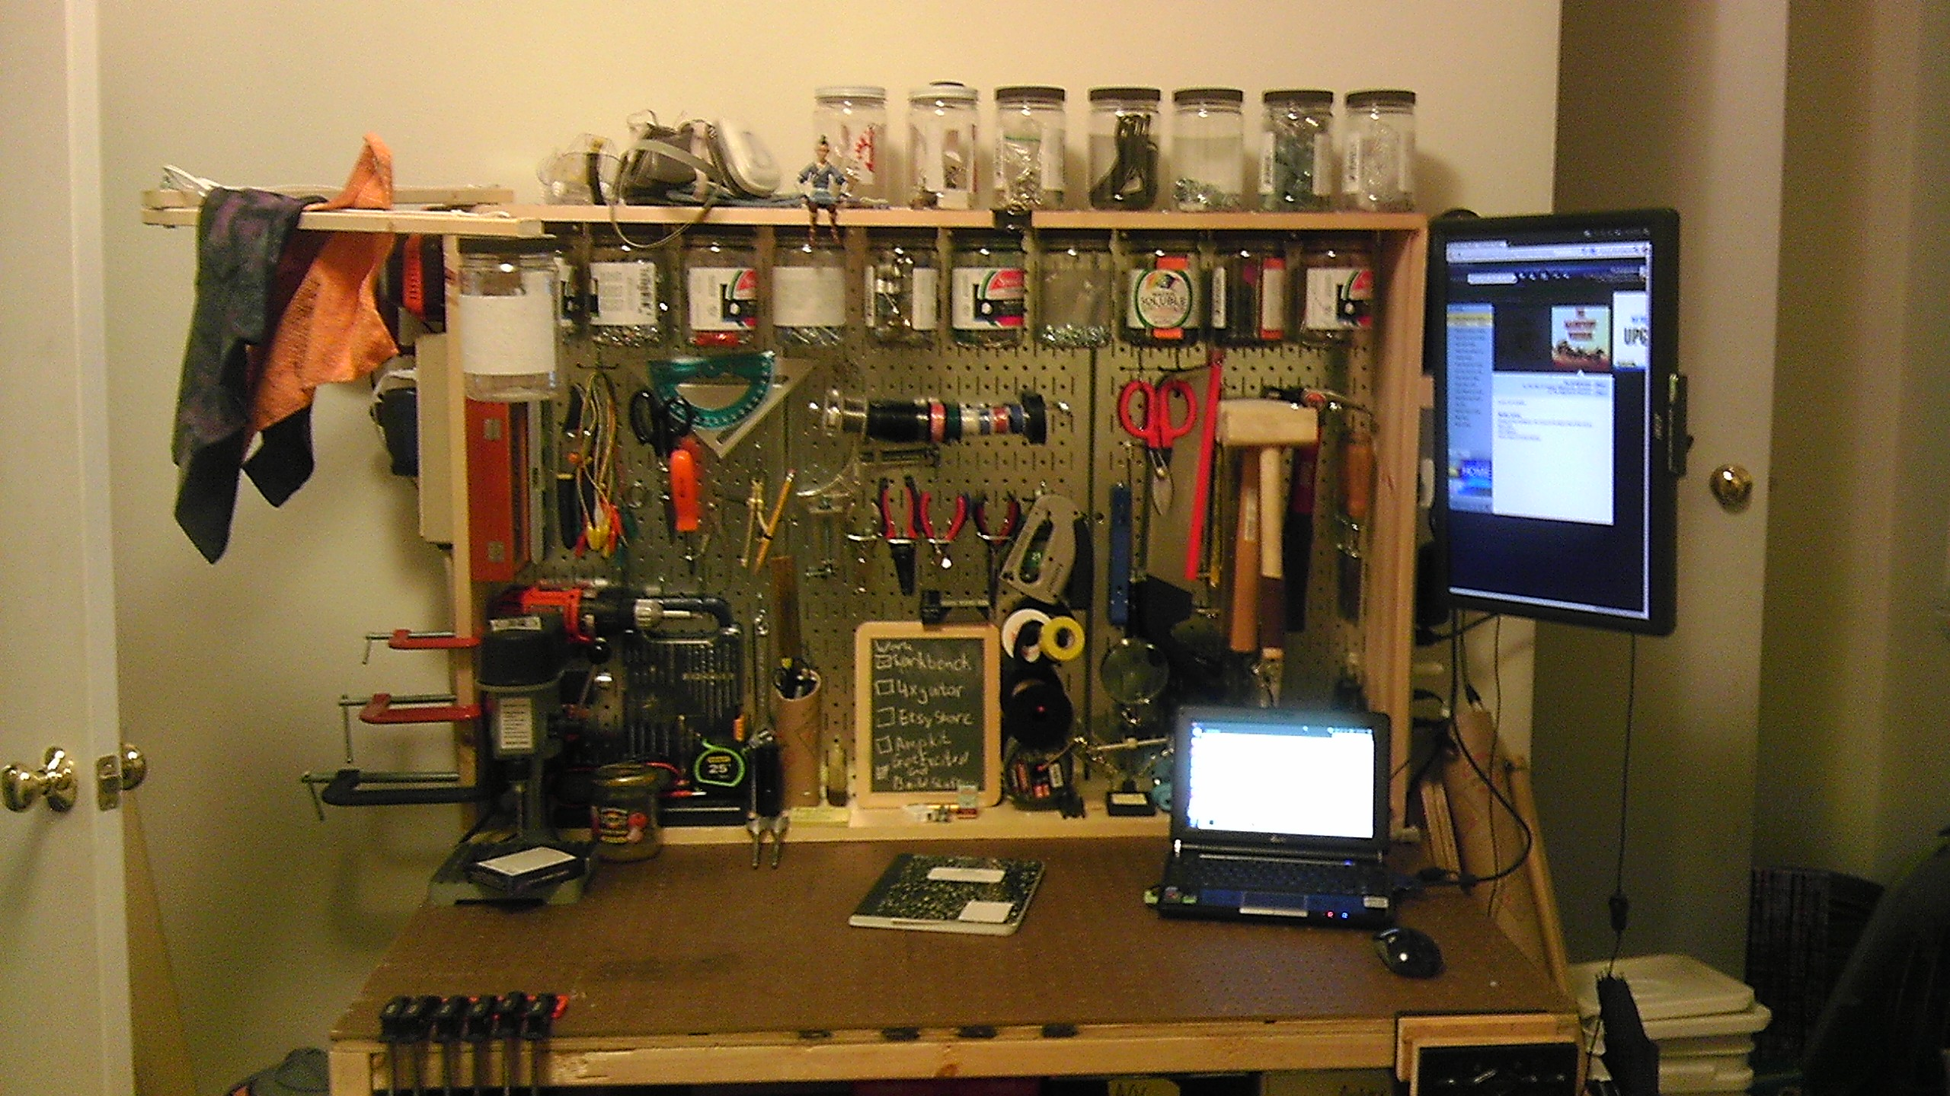
Keep Your Work Area Clean And Orderly
Neatly arrange all equipment and material.
Do not allow metal, parts, wires, scrap, or other material to accumulate on the shop floors or in the work areas.

Slide 14
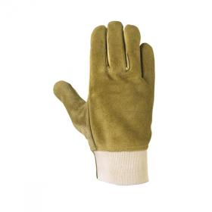
Know When To Wear Gloves And Not To Wear Gloves
Gloves should be worn when casting.
Gloves should NOT be worn when operating cutting tools or tools that contain rotating spindles, such as drills.

Slide 15
Make Sure You Are Sober And Awake
Never work in the shop if you are tired, in a hurry, or under the influence.
Don’t rush or take chances. Obey all safety rules.

Slide 16
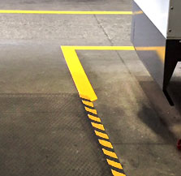
Give workers space – if someone is working on a machine, don’t interrupt them
Look for yellow and black tape marking machine areas where makers need extra room.

Slide 17
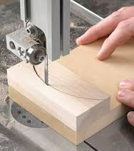
Keep a 4” margin of safety when using machines. Don’t move your fingers too close to blades, drills, or other moving parts

Slide 18
Know where to locate first aid equipment
There is a general first aid area in the kitchen, but there are additional areas in the shop and core.

Slide 19
Practice safety around electricity
Locate breaker boxes so you can quickly find them in an emergency.
Check your tool to make sure the cords are not damaged before you plug it in.

Slide 20

Take care of your tools, take care of your space, but especially, take care of the tools you cannot replace.

